Slide 1
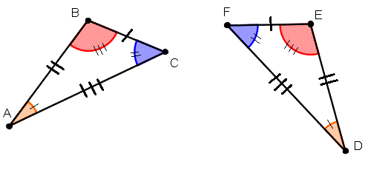
My Geometry Interactive Notebook
Name:
Class: 9-5
Teacher: Miss L
Term 2 Semester 1

Slide 2
Similar Triangles
Can be overlayed one on top of the other – so it’s easy to see corresponding angles are equal

Slide 3
If 2 triangles are similar, then their matching pairs of sides are in ratio
d
b
c
a
e
f
Provided they’re similar, that is, the angles of one are equal to angles of the other

Slide 4
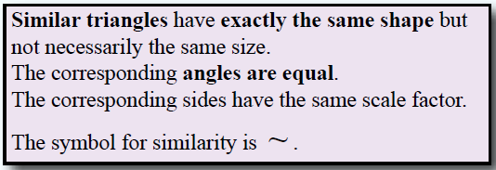
24
7
30
Topic: Similar Triangles
Date
EQ - How can I determine if two triangles are similar?
What are Similar Triangles?

Slide 5
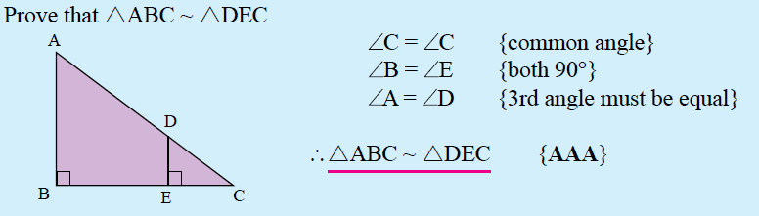
Examples

Slide 6
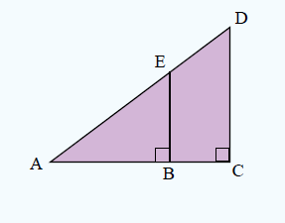
Examples

Slide 7
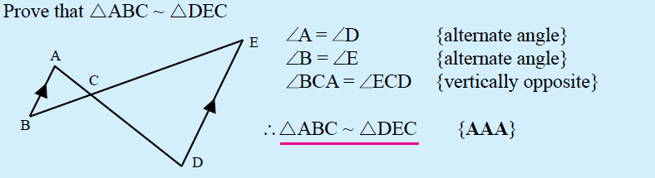
Examples

Slide 8
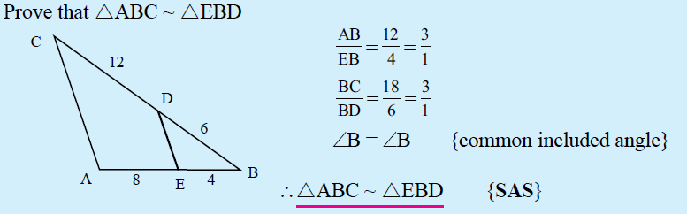
Examples

Slide 9
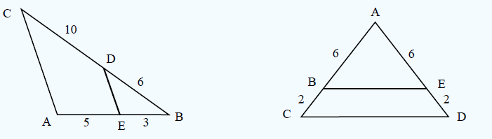
Examples

Slide 10
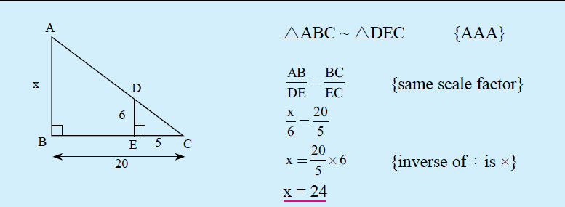
Examples

Slide 11
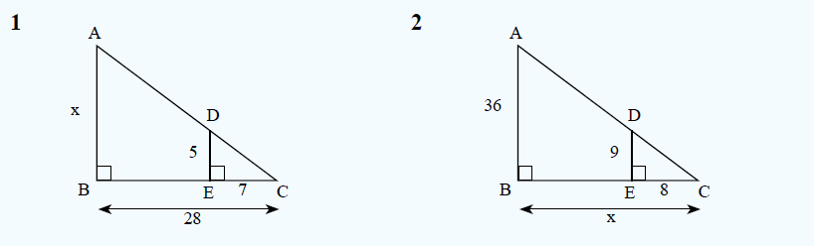
Examples

Slide 12
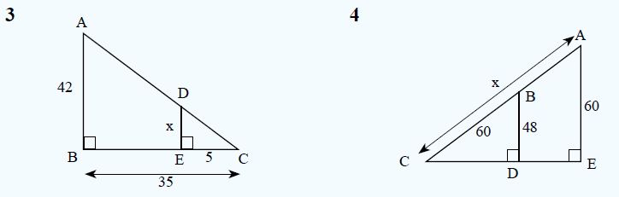
Examples

